Slide 1

Using News To Predict Stock Movement

Slide 2
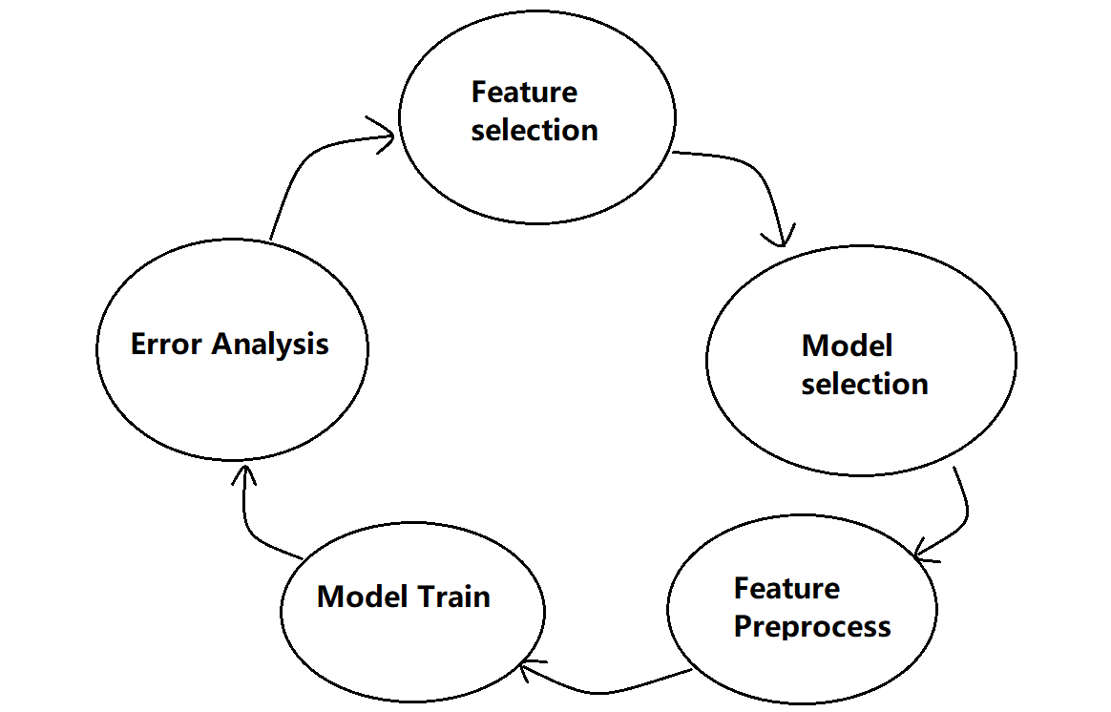
Overall Process

Slide 3
Feature Selection
feature meaning?
feature importance?
feature handle?
Read documentation
Google
Ask others
For human expert
Using figure
Numerical or categorical
If categorical, how many?

Slide 4
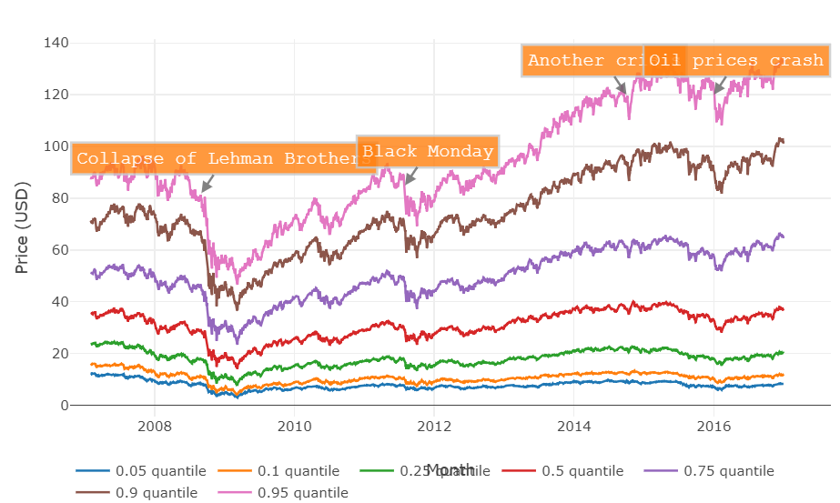
Feature Selection
For market Data
For news Data
Urgency: 3
Takesequence: 97
Provider: 30
Audiences: 88488
HeadlineTag: 163
…
After this, We choose two features from news data, and all the numerical features from market data

Slide 5
Model Selection
Logistic regression!
Criteria:
Simple model
Easy to be implemented
Fast to be trained
RAM: 17 G, Small extra memory cost
And this is a two-class classification problem…

Slide 6
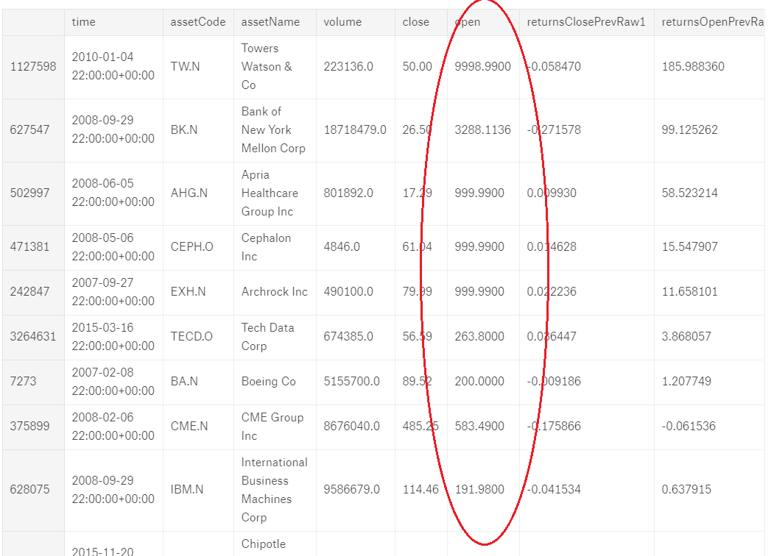
Feature preprocess
1. Handle the exceptional data

Slide 7
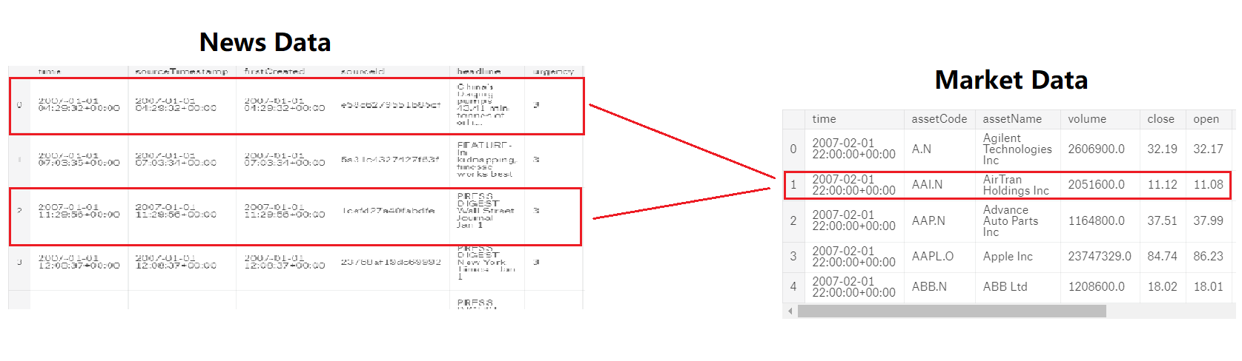
Feature preprocess
2. Combine the news data and market data.
HOW?

Slide 8

Feature preprocess
Normalize the data
We use standard score to normalize the data
2. Split the data to training data and validation data
First, drop the data before 2012, because…
Then, 70% training, 30% validation

Slide 9
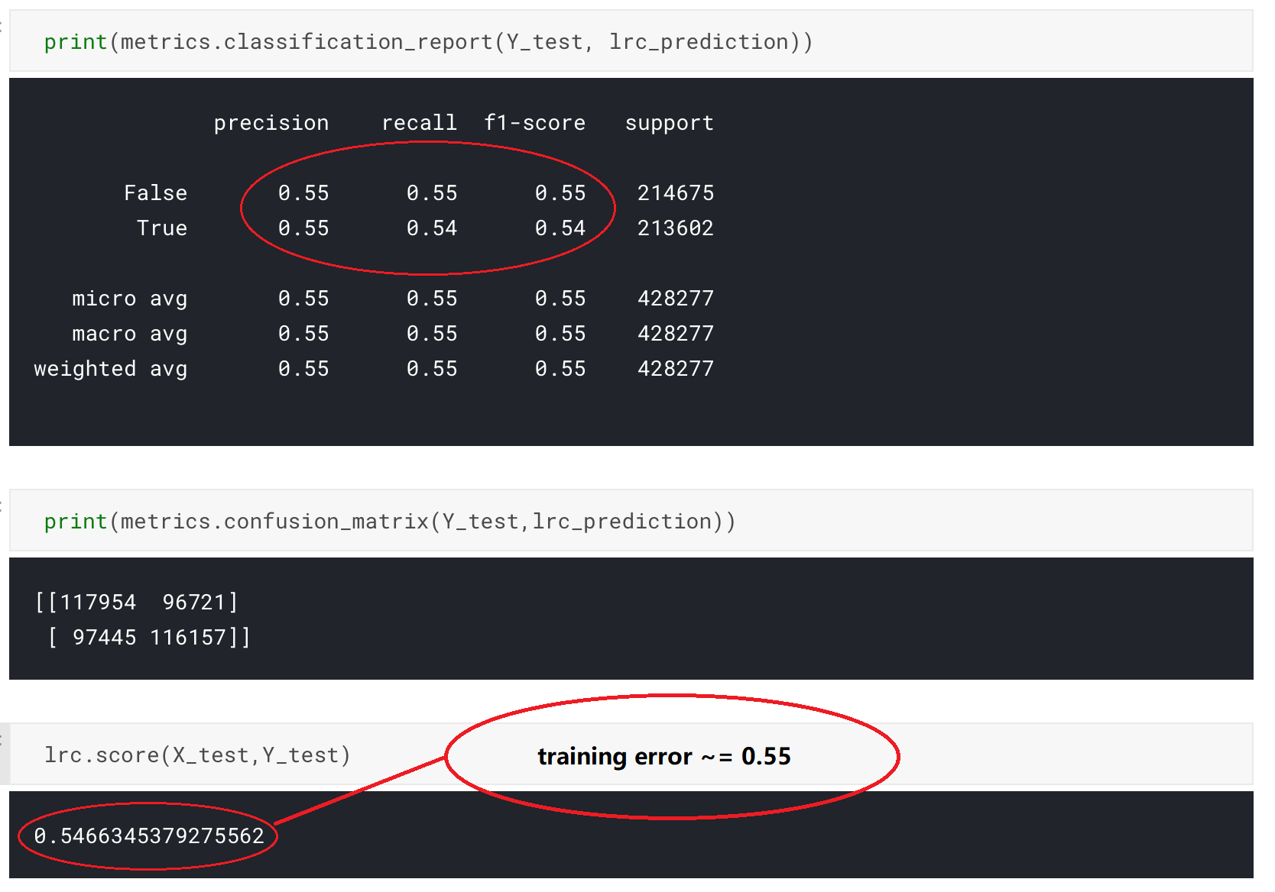
Model Train
change C, nothing changed…

Slide 10
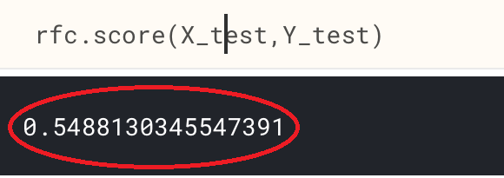
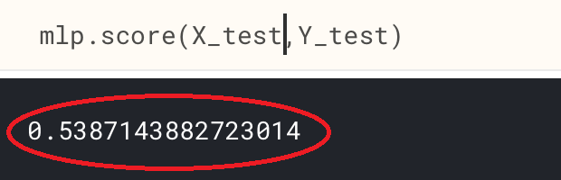
Model Train In order to make the model more complex:
Random Forest:
MLP:
There are so many training data, and the performance is so poor.

Slide 11
Error analysis
Not about the model, it is about the feature !
No error analysis yet.

Slide 12
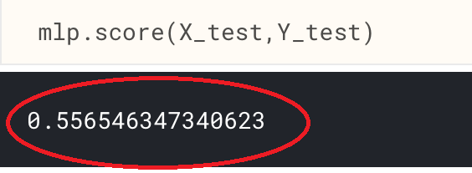
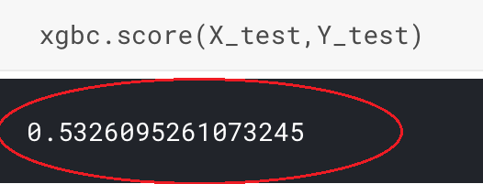
We go from feature selection to model train again.
Add all the numerical features of news data to market data
And we train the model again:
MLP:
XGBBoost:
We are still working on it!

